Slide 1








PetCareTopia
Pet CareTopia
Your Friendly Pet care

Slide 2





PetCareTopia
Team
Mohamed Samir
Mohamed Adel
. Mohamed Tarek
Toka Salah
Mohamed Ahmed
Mohamed Ramadan

Slide 3



PetCareTopia
Introduction
PetCaretopia is a web application that connects pet owners, shelters, and service providers.
It helps users adopt pets, book services like grooming or veterinary visits, and interact through a social platform.
The goal is to digitalize and simplify pet care for all stakeholders.

Slide 4




PetCareTopia
Problem Statement
Pet owners often struggle to find reliable service providers near them.
- The adoption process is still manual and unorganized.
Shelters have limited ways to promote pets.
- There is no centralized platform combining services, adoption, and pet community features.

Slide 5
Many users lack a clear overview of their pet's care history or appointments.
PetCareTopia
Problem Statement
Con.
Many users lack a clear overview of their pet's care history or appointments.
Communication between shelters, providers, and owners is fragmented and time-consuming.
Pet owners often need to visit multiple apps or websites to manage different services — from grooming to clinics to training. There's no one-stop solution.

Slide 6




PetCareTopia
Solutions
Our app solves these problems by:
Providing location-based service discovery.
Enabling online pet adoption requests and approvals.
Creating a social community for pet lovers.
- Offering a complete booking and rating system.

Slide 7
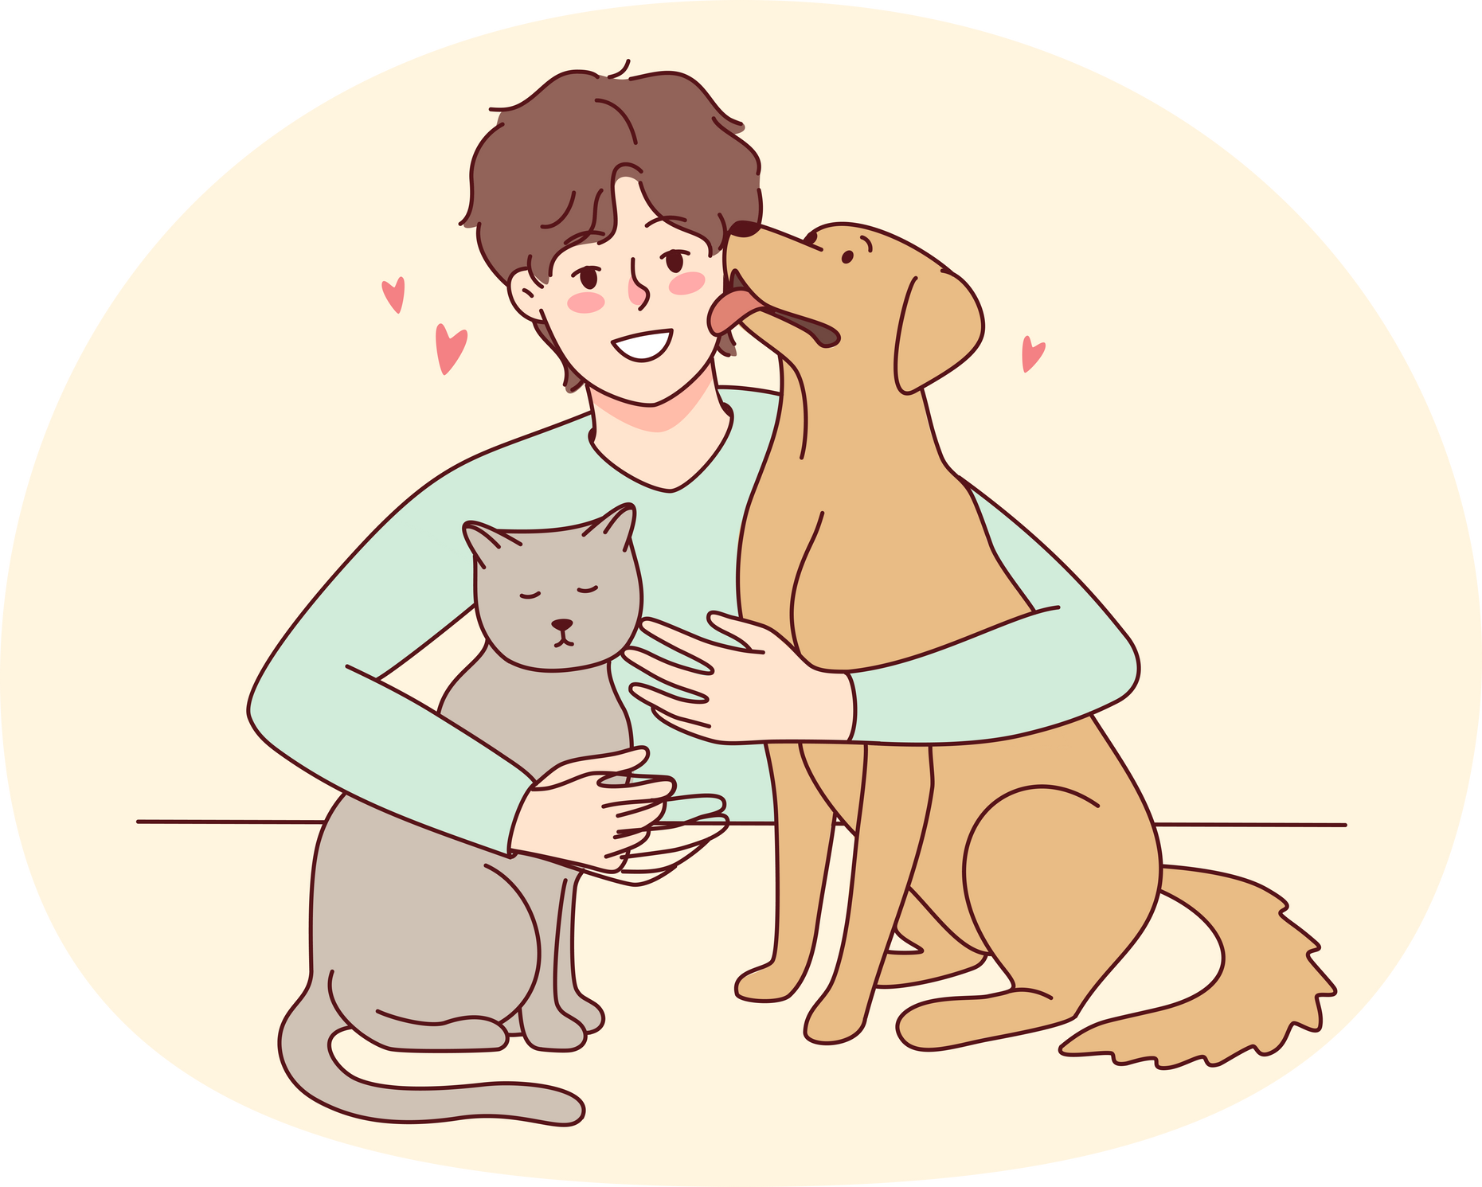



PetCareTopia
Solutions Cont.
-Centralizing all pet services (grooming, training, vet, boarding) in one platform.
-Saving pet owners time by eliminating the need for multiple apps.
-Helping shelters manage adoptions and pets more effectively.
-Using AI to identify pet breeds and improve pet care personalization.

Slide 8




PetCareTopia
Our Mission
At PetCaretopia, our mission is to simplify and enhance every aspect of pet care through smart, connected technology.
We aim to build a joyful, safe, and empowering ecosystem for pet owners, shelters, and service providers — making love, care, and connection easier than ever.
"Because every pet deserves a happy home — and every owner deserves a seamless way to get there."

Slide 9




PetCareTopia
Our Services
Pet Serving
Pet Adoption
Pet Breeding
From grooming and training to vet visits and boarding — our platform connects you with certified service providers near you.
Book sessions, track appointments, and give your pet the best care possible.
"All your pet’s needs in one place — clean, trained, healthy, and happy."
We offer a safe, controlled breeding environment where pet owners can connect, communicate, and request breeding with trusted matches through the platform.
"Connect your pet with verified partners and grow your fur family responsibly."
Explore hundreds of adoptable pets from shelters near you. Review detailed profiles, apply online, and bring home a new best friend — fast and easy.
"Find your perfect match and give a pet a second chance at happiness."

Slide 10
Caretopia
How PetCaretopia
Works
PetCaretopia is designed to serve 3 main users, each with their own set of features and benefits:
Service Providers
Pet Owner
Shelter Manger

Slide 11
For Pet Owners
Browse pets available for adoption.
Submit adoption requests online.
Book grooming or vet appointments
- Join the pet lovers' social community.

Slide 12
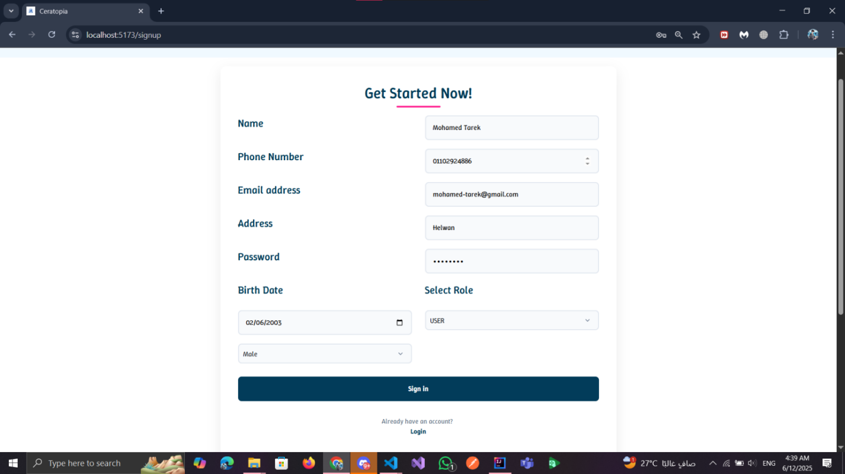
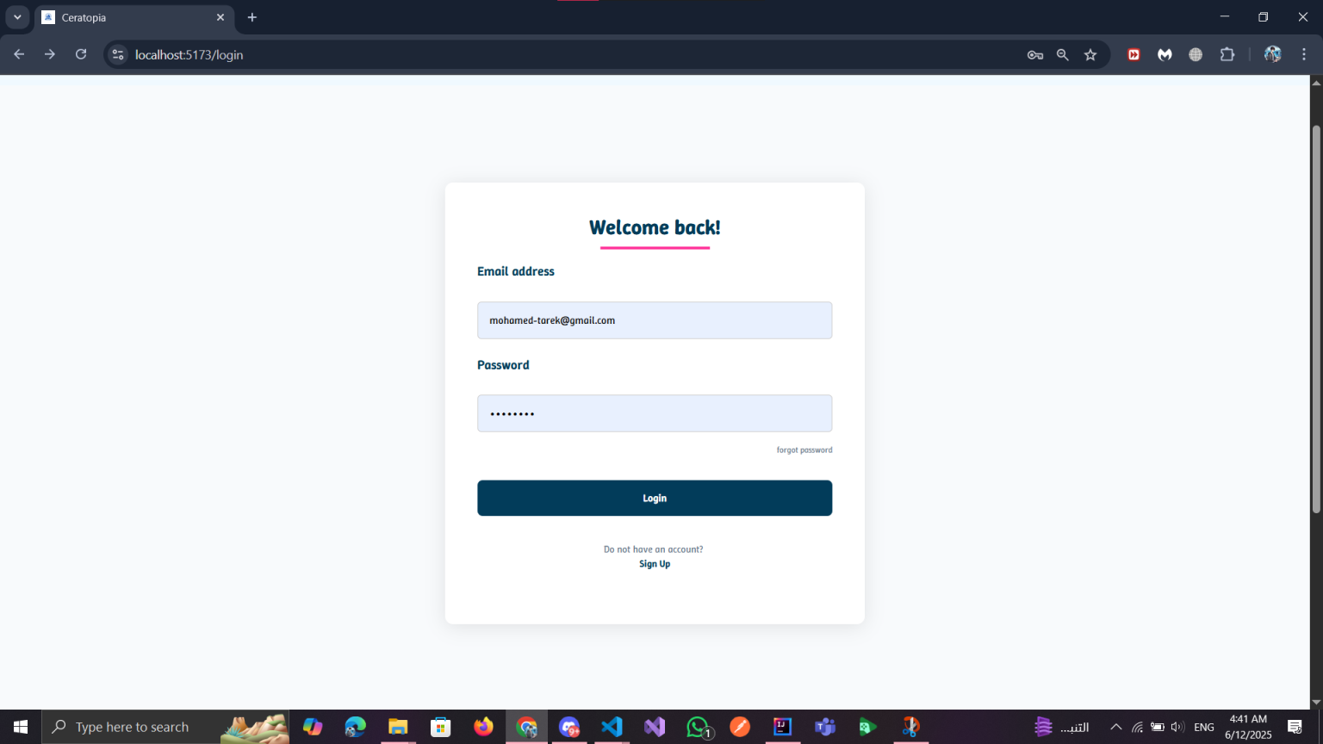
PetCareTopia
How It Works – Live from the System
Pet Owner Perspective CONT
Sign Up & Login
Easy Sign Up & Secure Login New users can register in seconds with basic info and role selection (pet owner, shelter Manger, or provider).
Returning users can log in securely to access their dashboard and services instantly.

Slide 13
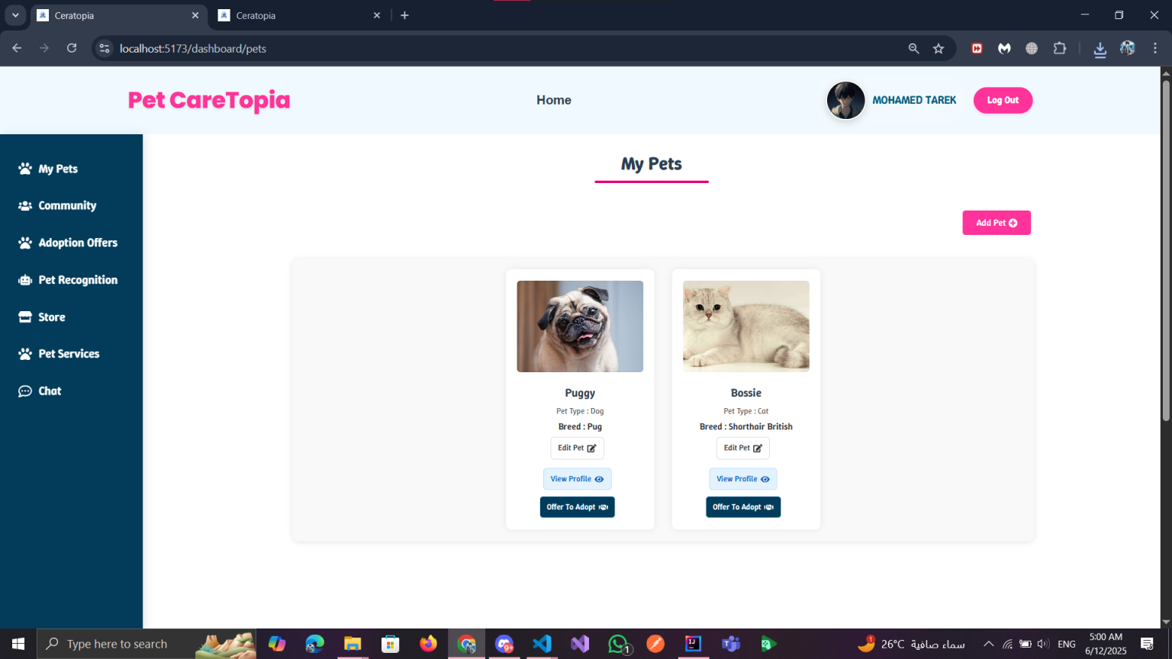
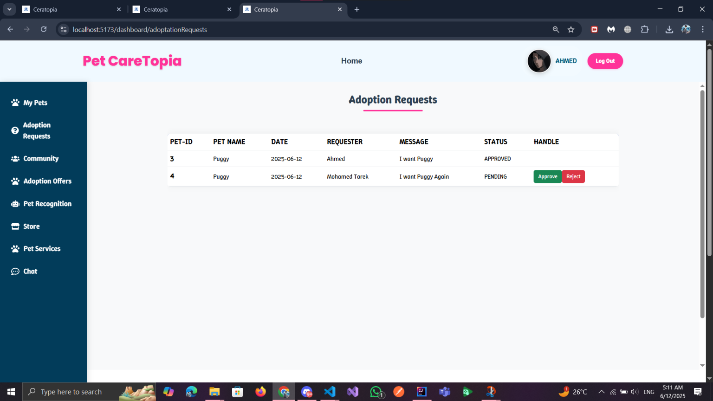
How It Works – Live from the System
Pet Owner Perspective CONT.
Submit adoption requests online.
-Adopt a Pet in Just a Few ClicksEasily.
-browse available pets, view their profiles, and send adoption requests directly from your dashboard.Track your request status and stay updated with real-time notifications.

Slide 14
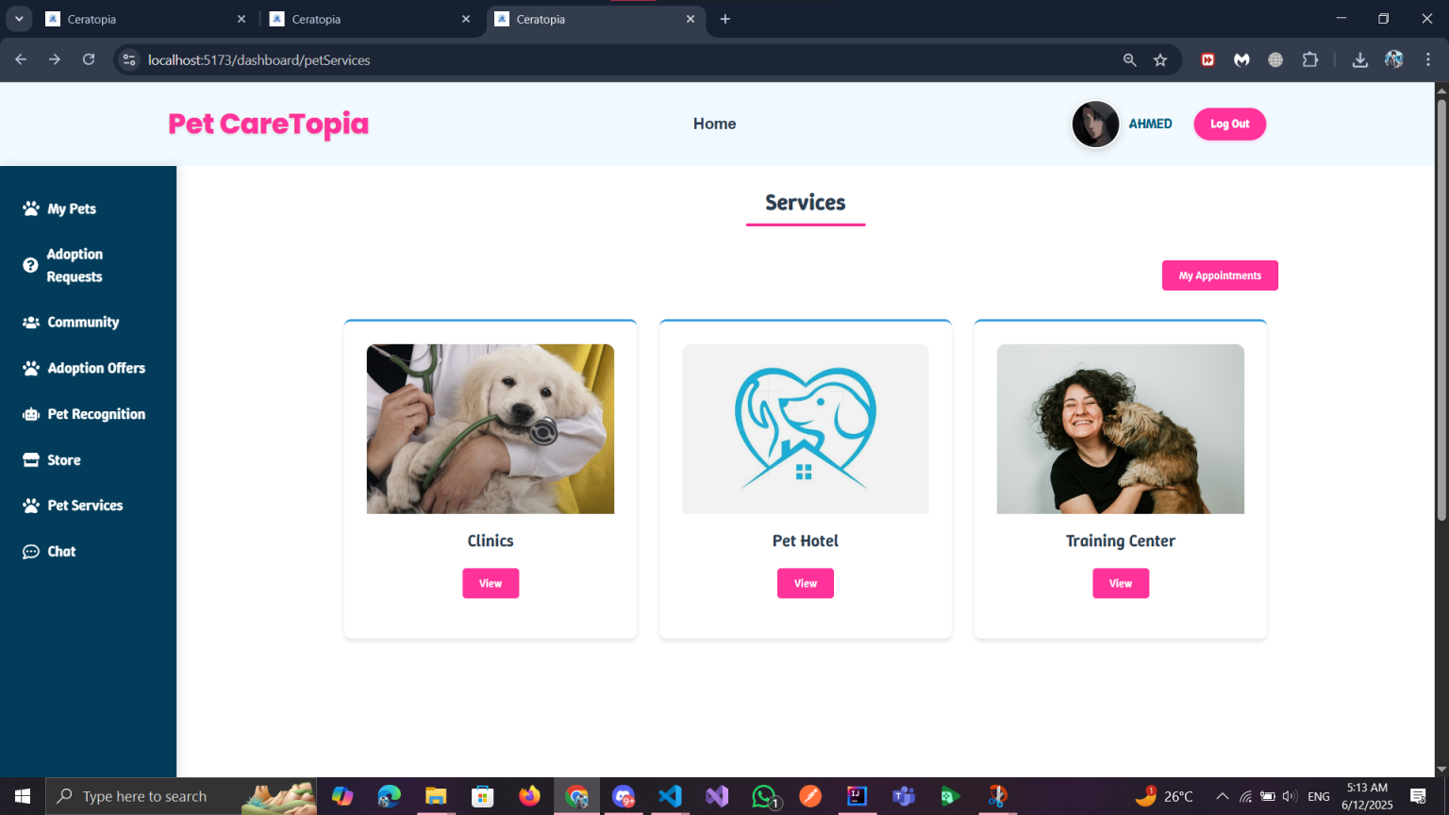
PetCareTopia
How It Works – Live from the System
Pet Owner Perspective CONT
Book hotels or vet appointments
Book Grooming & Vet Services in Seconds
Browse available pet services like clinics, hotels, and training centers.
Book your appointment directly through the dashboard — no calls, no hassle.

Slide 15
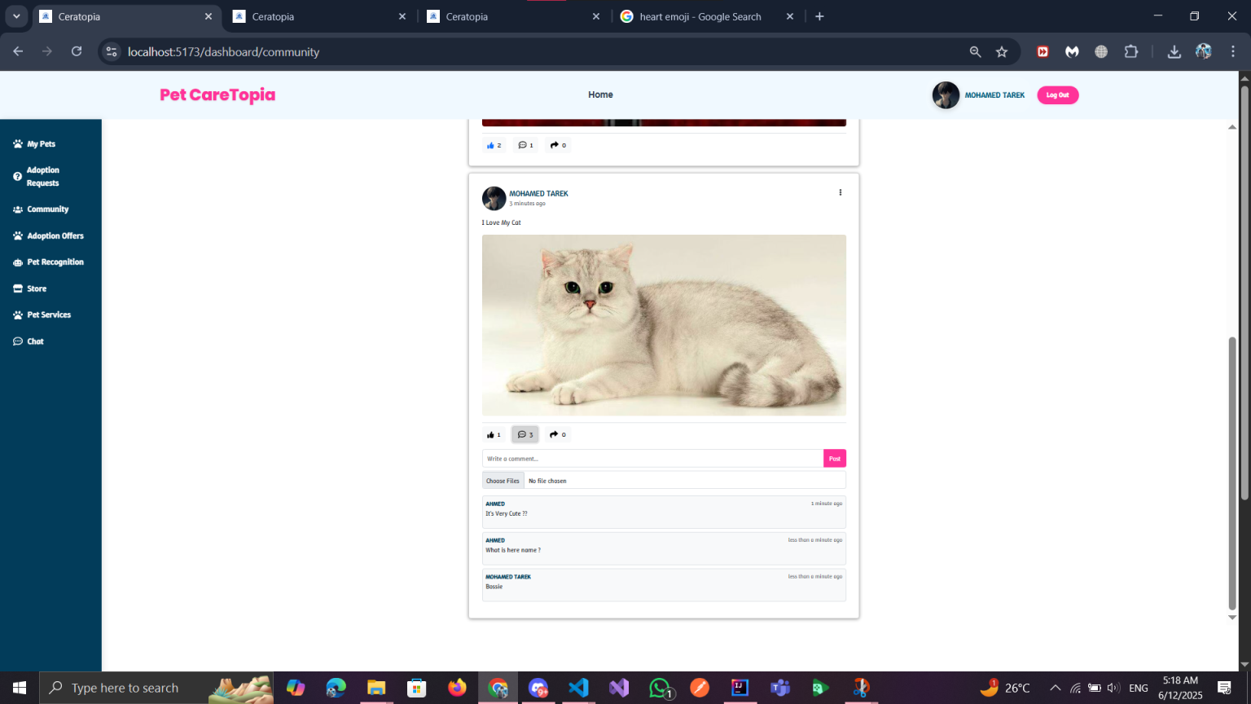
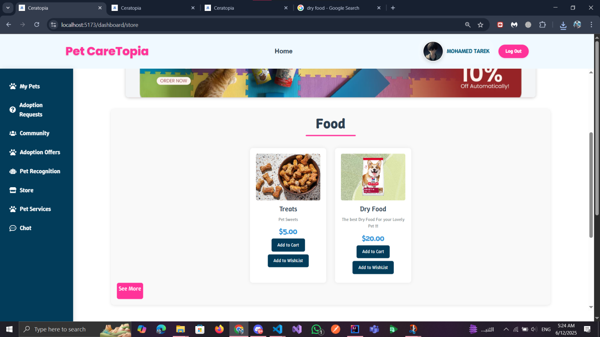
How It Works – Live from the System
Pet Owner Perspective CONT.
Join the Pet Lovers’ Community Share
photos, updates, and moments with fellow
pet owners.
Stay connected, comment, and
be part of a loving and interactive pet community.
Shop Pet Products in One Place From treats to dry food — browse, add to cart, or wishlist your favorite items directly from the PetCaretopia store.

Slide 16
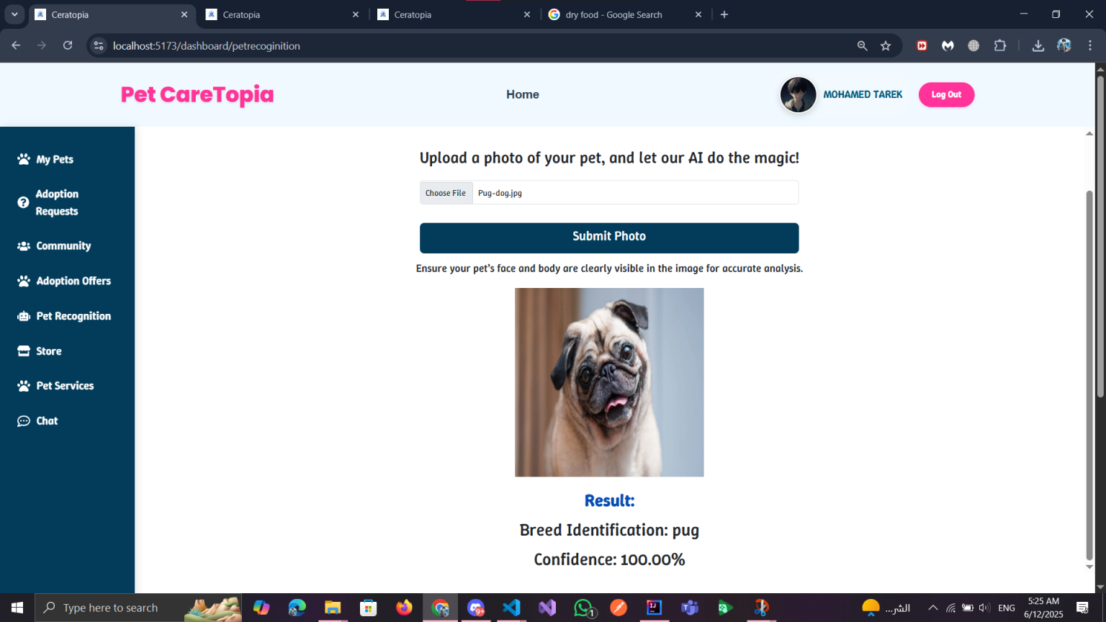
PetCareTopia
How It Works – Live from the System
Pet Owner Perspective CONT
AI-Powered Breed Recognition Upload your pet’s photo and let our AI detect the breed instantly — fast, accurate, and helpful for new adopters.
Key Benefits : Instantly identifies pet breed from a single image Helps shelters and adopters understand the pet’s needs Boosts trust by showing smart tech behind the platform Useful for clinics to keep accurate medical records

Slide 17



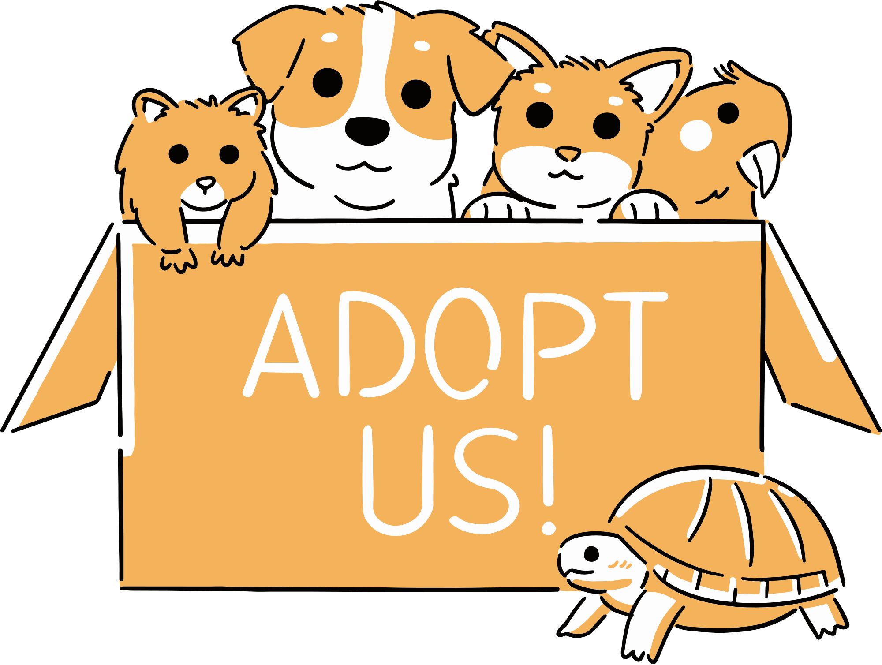
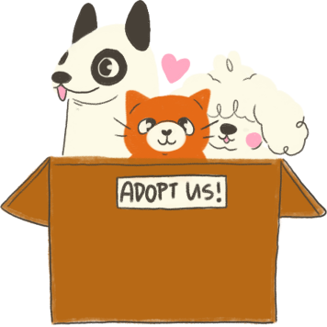
For Shelter Manager
List pets with details and pictures
Manage adoption requests.
Communicate directly with interested users
- Track pet history and adoptions digitally

Slide 18
For Service Provider
Register your clinic or Training center, Pet hotel.
Display services, prices, and availability
Accept and manage bookings
Build trust through reviews and ratings

Slide 19
PetCareTopia
Modules
Authentication & Roles
Pet Management
. Adoption Module
Service Provider Booking
Social Interaction
Admin Panel HEALTH
Store Module

Slide 20
PetCareTopia
System Features (User Perspective)
Add , mange its Pets and can offer them for Adoption
Register & login securely using JWT
Chat with anyone in the app
Adopt Pets From Adoption Offers
Add Posts & React with Posts in the Community
Buy Pets Products From Store
Recoinage Pet and Know its type & its Breed
View Providers Services & Book Appointments With Them
Mange & Edit his Account

Slide 21
PetCareTopia
System Features (Provider Perspective)
Register & login securely using JWT
Add his Role Type (VET,SITTER,TRAINER)
Chat with anyone in the app
Add & Mange his Facilities (Update , Delete)
Add Posts & React with Posts in the Community
Mange his Appointments (APPROVED , REJECTED , TREATED)
Mange & Edit his Account

Slide 22
PetCareTopia
System Features (Admin Perspective)
Mange User & Providers Accounts (Delete,Ban,InActive,Active)
Register & login securely using JWT
Chat with anyone in the app
Mange Products in the Store (Add,Delete,Update)
Add PetTypes & PetBreeds
Mange Store Orders (PROCESSING, SHIPPED,DELIVERED)
View Adoption Transactions
Mange Vaccines & Their Types (ADD,UPDATE,DELETE)
Mange Shelters (ADD,UPDATE,DELETE,AddPets)

Slide 23
PetCareTopia
Similar Systems
Petfinder
Vetster
Rover
Adopt-a-Pet

Slide 24


PetCareTopia
Thank You!

